Slide 1
LESSON EIGHT
TOPICS: HOW TO IMPLEMENT THE GUN DYNAMICS.

Slide 2
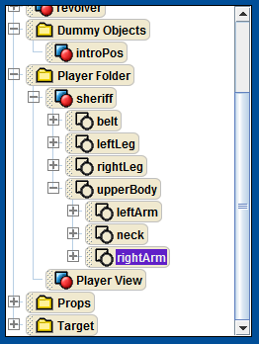
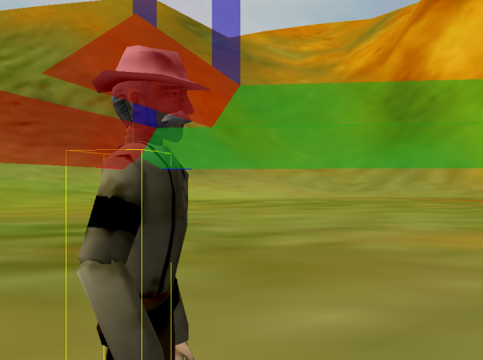
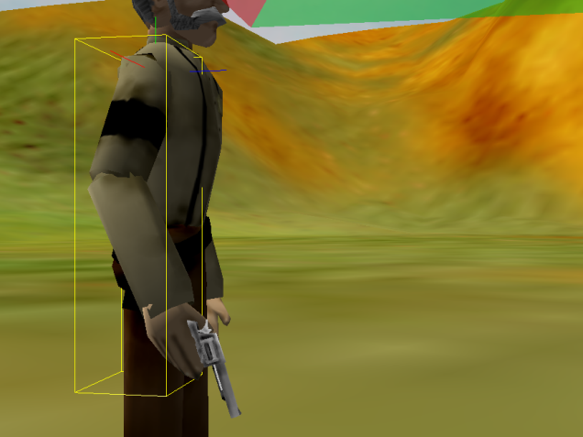
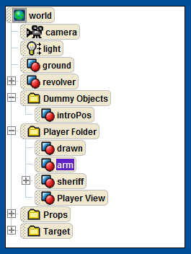
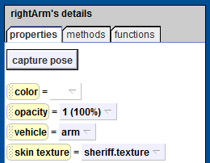
Step 1: Create Dummy Objects for Animating the Sheriff’s Arm
Find and select the sheriff’s rightArm in the object tree.
Drop a dummy object at the rightArm.
Rename the new dummy object “arm”.
Drop a second dummy object and rename it “drawn”.
Set the rightArm’s vehicle to the “arm” dummy object.
Move the two new dummy objects into the player folder.

Slide 3
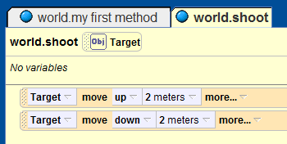
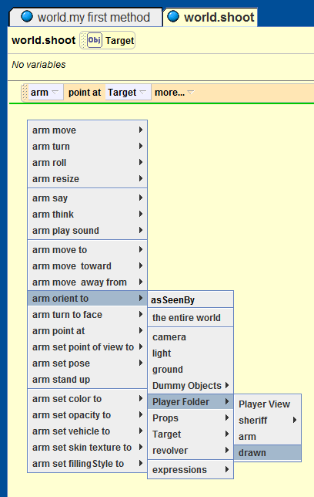
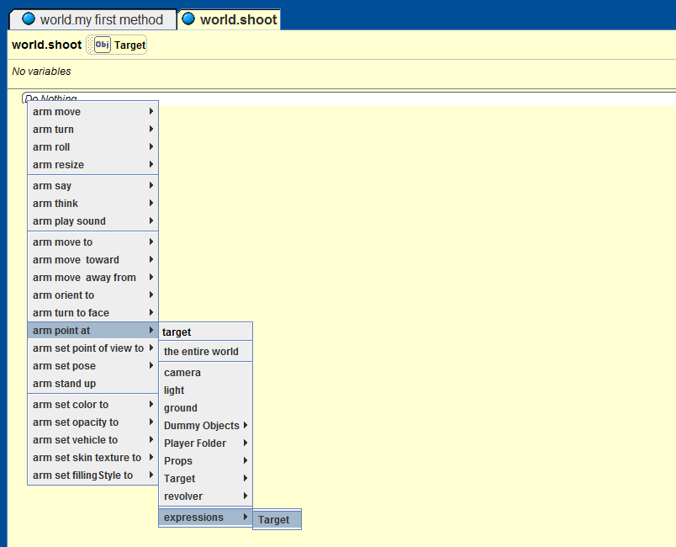
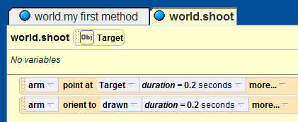
Step 2: Make the Sheriff Point at the Target
Delete the two lines of code that are currently in the world.shoot method.
Add the line “arm point at Target duration = 0.2 seconds” by dragging and dropping the arm dummy object into the code editor.
After the current line, add the line “arm orient to drawn durration = 0.2 seconds”.

Slide 4
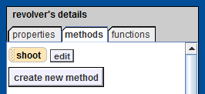
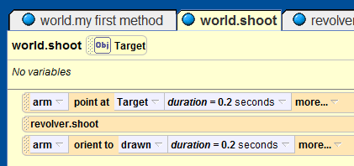
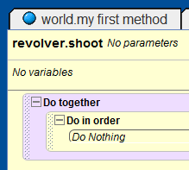
Step 3: Animate the Revolver
Add a new method to the revolver named “shoot”.
Add a reference to the revolver.shoot method in the world.shoot method between the current two lines of code in world.shoot.
To the revolver.shoot method, add a “Do together” statement. To the new do together statement, add a “Do in order” statement.

Slide 5
Group Exercise
Let’s learn about rotation!
Notes:
Remember to explain the difference between rolling and turning: turning is a rotation around the x or y-axis, whereas roll is a rotation around the z-axis.

Slide 6
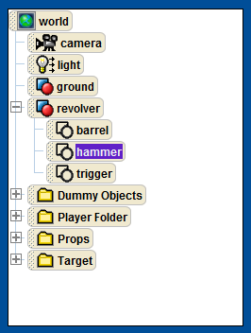
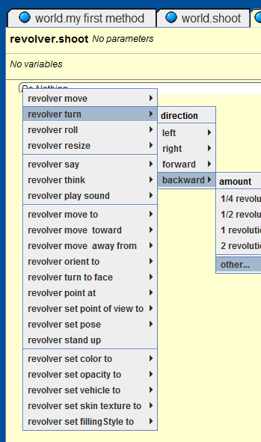
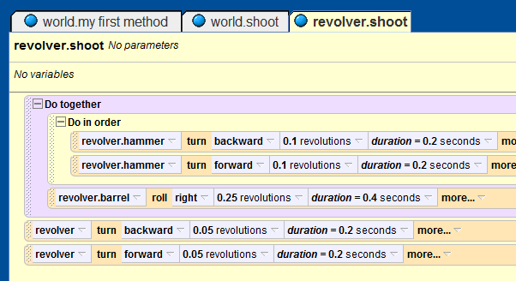
Step 4: Animate the Revolver Parts
Add the following two lines to the do in order statement in the revolver.shoot method:
“revolver.hammer turn backwards 0.1 revolvutions duration = 0.2 seconds” and “revolver.hammer turn forwards 0.1 revolvutions duration = 0.2 seconds”
Add “revolver.barrel roll right 0.25 revolutions duration=0.2 seconds” after the do in order statement in the do together statement.
Add the following two lines after the do together statement:
“revolver turn backwards 0.05 revolvutions duration = 0.2 seconds” and “revolver turn forwards 0.05 revolvutions duration = 0.2 seconds”

Slide 7
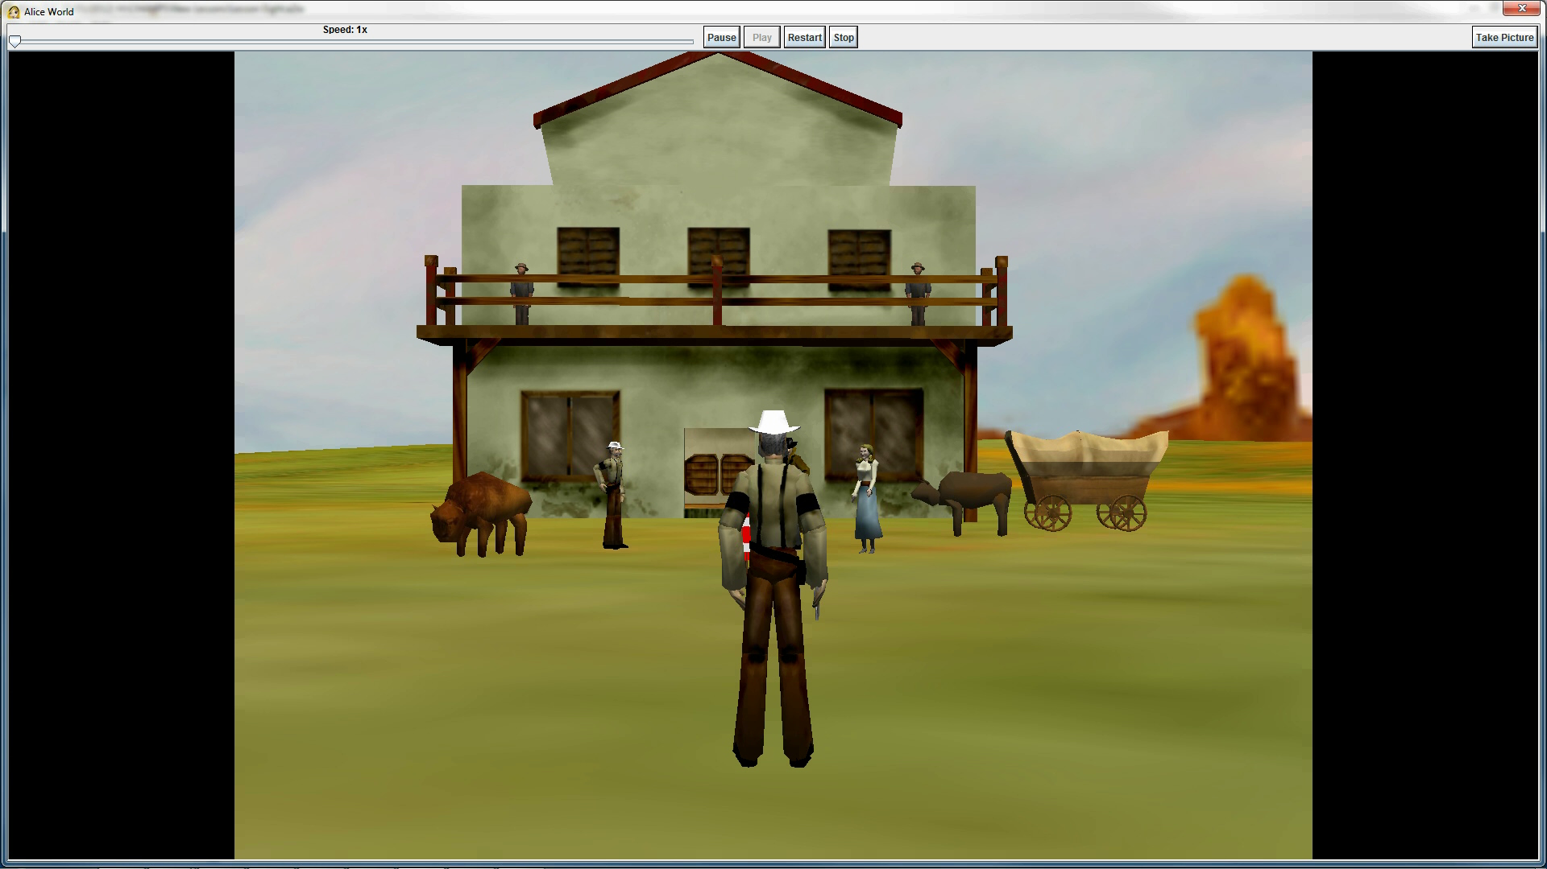
Final Scene

